Slide 1

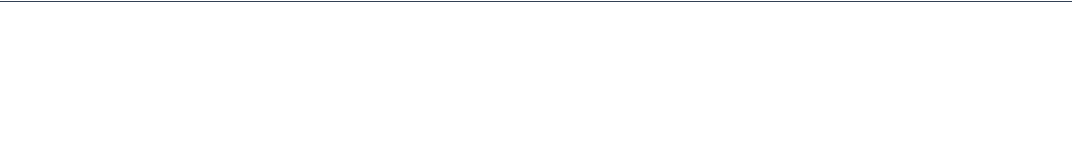
FLAPPY JAVA
Endless Flyer
Students: B Baby Suharshitha , Palle Amrutha
Batch No: 4
Course: CSA0920 - Programming in Java
Guide: Dr M Ramkumar
Review Number: 1

Slide 2







GAME CONCEPT OVERVIEW
Core Mechanics
Addictive Loop
Win/Loss Condition
A "one-tap" side-scrolling survival game where the player controls a bird navigating through narrow gaps.
Simple tap to jump against constant downward gravity. The loop is short, high-stakes, and infinitely repeatable.
Goal: Pass as many pipes as possible. Lose: Hit a pipe, the ground, or the sky ceiling.

Slide 3
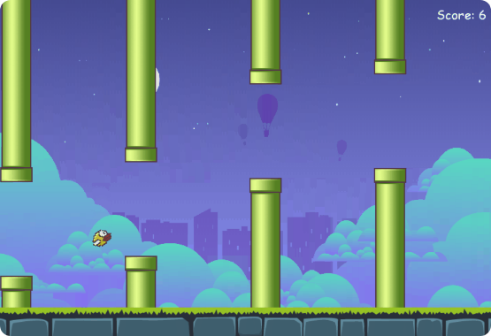

REFERENCE GAME STUDY
Analysis of Flappy Bird
Original success relied on "Punishing Simplicity"—easy to understand but extremely hard to master.
•
Reproduced: Gravity-velocity physics, collision hitboxes, and random pipe heights.
•
Simplified: Use of Java Graphics2D instead of a heavy physics engine; AABB (Rectangular) collision logic.

Slide 4
TARGETED LEARNING OUTCOMES
Multithreaded Real-time Loops: Implementing a consistent 60FPS refresh rate without blocking the UI.
Collision Detection Logic: Real-time overlap calculation between Bird and Pipe entities.
Custom 2D Rendering: Direct manipulation of Java AWT Graphics2D for high-performance redraws.
JDBC Persistence: Managing a persistent leaderboard using SQL connectivity for high scores.

Slide 5
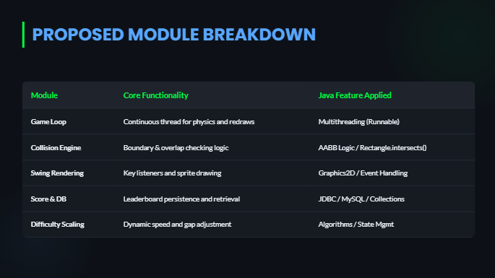

Slide 6

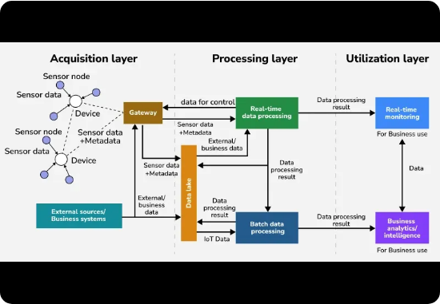
SYSTEM ARCHITECTURE
Data Flow Interaction
1. Input: Keyboard events trigger velocity changes in the Bird Model.
2. Game Loop: Background thread updates coordinates and checks Collision Engine.
3. Renderer: Redraws updated models using Double Buffering.
4. DB Layer: Writes score to MySQL on the "Game Over" state.

Slide 7






TECH STACK & WHY
Swing/AWT
ArrayList
MySQL + JDBC
Used for building the game window and utilizing the robust Graphics2D library for sprites.
Chosen for the Collections Framework to manage an infinite stream of dynamic pipe objects.
Provides permanent storage for players' names and high scores beyond individual game sessions.

Slide 8

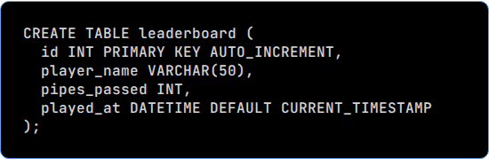
PROPOSED DATABASE SCHEMA
The table will record the score at the exact moment of collision (Game Over).

Slide 9
MULTITHREADING PLAN
Dedicated Game Thread
01
The entire game logic (physics, movement, collisions) will run on a separate Thread. This prevents the GUI Freeze that occurs if long-running loops or Thread.sleep() were executed on the Event Dispatch Thread (EDT).
"Separating Logic from Presentation ensures smooth animation while remaining responsive to user keyboard inputs."

Slide 10



EXCEPTION HANDLING PLAN
Asset Loading
SQL Connectivity
IOException: Gracefully manages missing bird or pipe sprites by reverting to colored rectangles if files fail to load.
SQLException: Handled with try-catch blocks to ensure the game doesn't crash if the database is offline.
Thread Interrupts
InterruptedException: Safely shuts down the game loop thread during program exit or window closing.

Slide 11




WORK PLAN & TIMELINE
Week 1
Week 2
Week 3
Week 4
GUI Skeleton & Bird Physics Engine
Pipe Generation & Collision Logic
JDBC Setup & Leaderboard UI
Difficulty Tuning & Final Polish

Slide 12

CHALLENGES & Q&A
Hitbox Precision: Handling collision between rectangular pipes and non-rectangular bird shapes.
Frame Rate Sync: Keeping animation smooth across different hardware performance levels.
Thread Safety: Safely updating shared state variables between the logic thread and drawing thread.

Slide 13




IMAGE SOURCES
https://market-resized.envatousercontent.com/previews/files/181055324/flappy-winter-bird-game-character-sprite-sheet-sidescroller-game-asset-animation-gui-mobile-games-gameart.jpg?w=590&h=590&cf_fit=crop&crop=top&format=auto&q=85&s=6d1065bca2cda06338bf71f911faf83d05d9a3616b42164428f0772c7d3e5376
Source: graphicriver.net
https://media.geeksforgeeks.org/wp-content/uploads/20250304153519827498/Data-Flow-Diagram.webp
Source: www.geeksforgeeks.org
https://storage.needpix.com/rsynced_images/database-schema-1895779_1280.png
Source: www.needpix.com
https://static.vecteezy.com/system/resources/thumbnails/074/124/752/large/retro-pixel-art-game-over-screen-with-glitch-effect-arcade-style-old-school-game-display-free-video.jpg
Source: www.vecteezy.com

